Slide 1
Optimizing Website Request Intake: An In-Depth Analysis
Marketing Operations: Activation Pillar
Irfan Khan & Hari Kiran

Slide 2
Agenda
Welcome
Introduction to Website Request Intake form - Smartsheet
Best Practice: Content creation on Website
Website Request Process
Introduction to Asset Request Intake form VIA/Service-now
Asset Types and Best Practice
Q&A

Slide 3

Marketing Operations Open Office Hours
Get your questions answered by the marketing operations team. Open Office Hours are held monthly with the following agenda:
Learn about a tip or best practice
Ask a question – Pre-submit your questions here or ask during the office hours
Learn how to leverage IQVIA’s marketing systems and processes most effectively
Action: Sign up here, if you need to be added to the outlook invite
Reminder: Save your questions for the end or enter in the chat. We will address as many as we can!

Slide 4
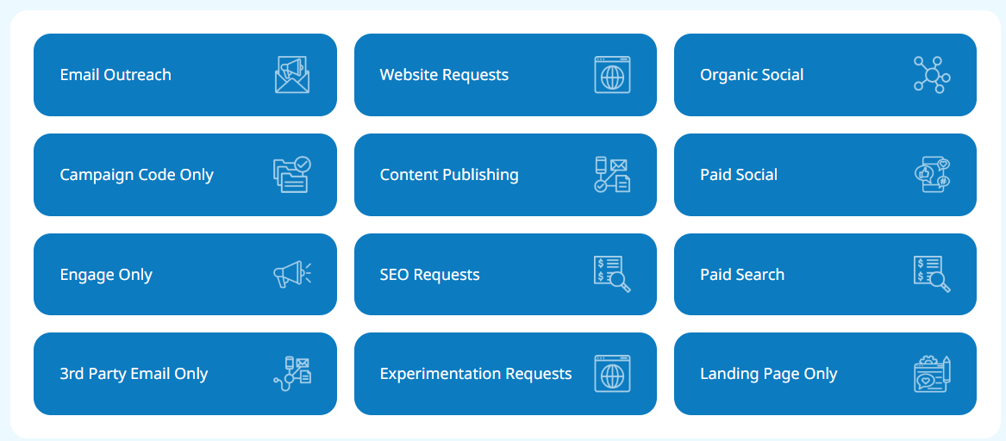
Introduction to Website Request Intake form - Smartsheet
Firstly go to the Marketing Operations Toolbox
Complete this form to submit new website request to the Web Ops team.
Types of Webpage update requests:
Create Page
Update Page
Create vanity URL
Create and update Navigation
SLA - Requests are completed within five U.S. business days.
Please contact web.support@iqvia.com if you have any additional questions.

Slide 5

Best Practice: Content creation on Website
Make sure the content is approved and not a duplicate.
Visit webpage module templates within brand world and select modules which suits your content.
Page update: Please provide ppt slides while changing design of the page instead a word doc/pdf.
Use word document to provide plain text for Blogs, Events & News pages.
Make sure to use the correct form for your requirement.

Slide 6
High level steps for a new Page Creation/Update on website​
Solution Page Request
Review Stage
Page Setup Initiated
Review with Marketer
Publish to live
Start building page based on information provided by marketer.
Preview links will be shared to get feedback/approval
Update the page based on feedback
Once we get the final approval will take the page to live environment.
Request initiated by Marketer through request form
Team review the ticket and ensure all information are in place.
Will reach out to Marketer if anything is missing/need further information.

Slide 7
Introduction to Website Request Intake form – Service Now

Slide 8
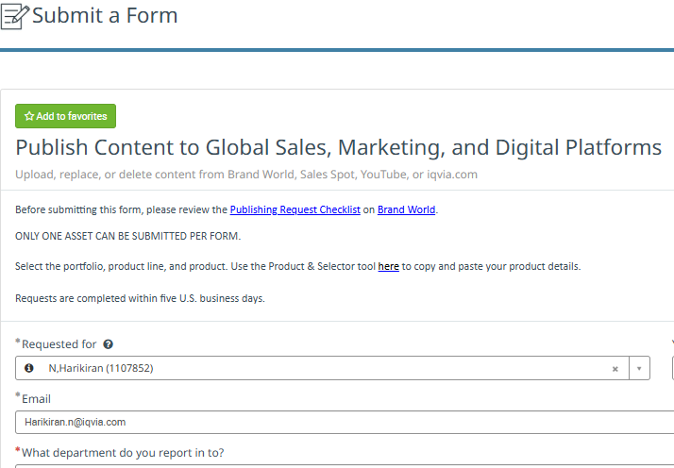
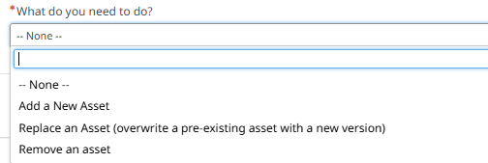
Introduction to Website Request Intake form
Complete this form to submit Asset page request to the Web Ops team.
This allows us to get the PDF posted to Brand World, the website, and Sales Spot.
Types of requests:
Add new asset
Replace an asset
Remove an asset
Only one asset can be submitted per form.
SLA - Requests are completed within five U.S. business days.

Slide 9




Asset types:
Fact Sheet, Whitepaper, Case Study, Publication, Brochures, Infographics, Insight Brief, Institute report & Presentation… (PDF files)
Video asset ( Brightcove link)
Podcasts ( Buzzsprout link )

Slide 10
Best Practice: Content creation on Website
Make sure the asset is brand approved.
To Add New Asset page:
Make sure to provide SEO keywords and description to be included so the page can rank better on search platform.
Featured image to be provided from Brand World.
Appropriate tagging and taxonomy must be provided.
Asset headline and subtitle to be provided under character limit.
Headline: 82 Character
Subtitle: 250 Character
To Remove an Asset: Relevant redirect link to be provided
To Replace an Asset: PDF and asset page link to be provided.

Slide 11
High level steps for a new asset page creation
Uploads assets to Sales Spot
Sales Spot Team
Asset Ticket
Request initiated by Marketer through VIA
Creative Service Team
Uploads assets to Brandworld
Web Ops Team
Creates asset web page in IQVIA.com

Slide 12
Q&A

